Slide 1
The Core
Lecturer: Ngo Huy Bien
Software Engineering Department
Faculty of Information Technology
VNUHCM - University of Science
Ho Chi Minh City, Vietnam
nhbien@fit.hcmus.edu.vn

Slide 2

Objectives
To create a WordPress theme.
To create custom code for a WordPress instance.

Slide 3

Contents

Slide 4

References
Brad Williams, David Damstra, Hal Stern (2015). Professional WordPress - Design and Development. Wrox.
Adam Onishi (2013). Pro WordPress Theme Development. Apress.
http://code.tutsplus.com/series/using-wordpress-for-web-application-development--wp-34105

Slide 5
What's in the Core? [1]
The WordPress core files are primarily PHP files, but also contain CSS, JavaScript, HTML, and image files. These files control everything about WordPress including how content pages are generated to display, loading the configured theme and plugins, loading all options and settings, and much more.
In short, the core contains several major function types:
Posts, pages, and custom content —Creating, storing, retrieving, and interacting with the majority of your content in WordPress.
Post types, taxonomies, and metadata —Everything from custom post types, tags, and categories to user‐created taxonomies.
Themes —Supporting functions for WordPress themes.
Actions, filters, and plugins —Framework for extending WordPress through plugins.
Users and authors —Creating and managing access control to your site, and key to the security and enterprise use topics.
Feeds, formatting, and comments

Slide 6
Exploring the Core
The WordPress core has certain files that contain many of the more popular WordPress functions.
These functions are used for all WordPress APIs and can be used in any custom plugin or theme.
All of the files listed in the section that follows are located in the /wp‐includes directory of WordPress.
The functions.php file contains the main WordPress API functions. These functions are used to easily interact with WordPress using a standardized method. Plugins, themes, and the WordPress core all use these functions
The option.php file contains the main WordPress Options API functions.
The formatting.php file contains the WordPress API formatting functions.
The pluggable.php functions fi le lets you override certain core functions of WordPress.
The plugin.php file contains the WordPress Plugin API functions.
The user.php file contains the WordPress User API functions.
The post.php file contains the functions used in the post process of WordPress.
The taxonomy.php file contains the functions used by the WordPress Taxonomy API.

Slide 7


Slide 8
The Loop
The Loop refers to how WordPress determines what content (posts, pages, or custom content) to display on a page you are visiting.
The Loop can display a single piece of content or a group of posts and pages that are selected and then displayed by looping through the content; thus, it's called the Loop.
To understand the Loop, it helps to break down the steps WordPress takes to generate a page's content.

Slide 9
From URL to index.php
The URL is matched against existing files and directories in the WordPress installation.
If the file is there, it is loaded by the web server.
WordPress doesn't actually get involved in this decision; it's up to your web server and the .htaccess file created by WordPress to decide if the URL is something handled by the web server or to be turned into a WordPress content query.
The web server starts by loading the WordPress core through index.php to begin the setup for the Loop.

Slide 10
index.php
<?php
/**
* Front to the WordPress application. This file doesn't do anything, but loads
* wp-blog-header.php which does and tells WordPress to load the theme.
*
* @package WordPress
*/
/**
* Tells WordPress to load the WordPress theme and output it.
*
* @var bool
*/
define( 'WP_USE_THEMES', true );
/** Loads the WordPress Environment and Template */
require __DIR__ . '/wp-blog-header.php';

Slide 11
wp-blog-header.php
<?php
/**
* Loads the WordPress environment and template.
*
* @package WordPress
*/
if ( ! isset( $wp_did_header ) ) { $wp_did_header = true;
// Load the WordPress library.
require_once __DIR__ . '/wp-load.php';
// Set up the WordPress query.
wp();
// Load the theme template.
require_once ABSPATH . WPINC . '/template-loader.php'; }

Slide 12
wp-load.php
/*
* If wp-config.php exists in the WordPress root, or if it exists in the root and wp-settings.php
* doesn't, load wp-config.php. The secondary check for wp-settings.php has the added benefit
* of avoiding cases where the current directory is a nested installation, e.g. / is WordPress(a)
* and /blog/ is WordPress(b).
*
* If neither set of conditions is true, initiate loading the setup process.
*/
if ( file_exists( ABSPATH . 'wp-config.php' ) ) {
/** The config file resides in ABSPATH */
require_once ABSPATH . 'wp-config.php';
}

Slide 13
wp-config.php
...
/** Absolute path to the WordPress directory. */
if ( ! defined( 'ABSPATH' ) ) {
define( 'ABSPATH', __DIR__ . '/' );
}
/** Sets up WordPress vars and included files. */
require_once ABSPATH . 'wp-settings.php';

Slide 14
wp-settings.php
/**
* Version information for the current WordPress release.
*
* These can't be directly globalized in version.php. When updating,
* we're including version.php from another installation and don't want
* these values to be overridden if already set.
*
* @global string $wp_version The WordPress version string.
* @global int $wp_db_version WordPress database version.
* @global string $tinymce_version TinyMCE version.
* @global string $required_php_version The required PHP version string.
* @global string $required_mysql_version The required MySQL version string.
* @global string $wp_local_package Locale code of the package.
*/
global $wp_version, $wp_db_version, $tinymce_version, $required_php_version, $required_mysql_version, $wp_local_package;
require ABSPATH . WPINC . '/version.php';
require ABSPATH . WPINC . '/load.php';

Slide 15
load.php
<?php
/**
* These functions are needed to load WordPress.
*/
/**
* Return the HTTP protocol sent by the server.
*
* @return string The HTTP protocol. Default: HTTP/1.0.
*/
function wp_get_server_protocol() {
$protocol = isset( $_SERVER['SERVER_PROTOCOL'] ) ? $_SERVER['SERVER_PROTOCOL'] : '';
if ( ! in_array( $protocol, array( 'HTTP/1.1', 'HTTP/2', 'HTTP/2.0', 'HTTP/3' ), true ) ) {
$protocol = 'HTTP/1.0';
}
return $protocol;
}

Slide 16
wp-blog-header.php
<?php
/**
* Loads the WordPress environment and template.
*
* @package WordPress
*/
if ( ! isset( $wp_did_header ) ) { $wp_did_header = true;
// Load the WordPress library.
require_once __DIR__ . '/wp-load.php';
// Set up the WordPress query.
wp();
// Load the theme template.
require_once ABSPATH . WPINC . '/template-loader.php'; }

Slide 17
Template Terminology
https://developer.wordpress.org/themes/basics/template-files/
The term “template” is used in different ways when working with WordPress themes:
Templates files exist within a theme and express how your site is displayed.
Template Hierarchy is the logic WordPress uses to decide which theme template file(s) to use, depending on the content being requested.
https://developer.wordpress.org/themes/basics/template-hierarchy/
Page Templates are those that apply to pages, posts, and custom post types to change their look and feel.
https://developer.wordpress.org/themes/template-files-section/page-template-files/

Slide 18
template-loader.php
if ( wp_using_themes() ) {
$tag_templates = array(
'is_embed' => 'get_embed_template',
'is_404' => 'get_404_template',
'is_search' => 'get_search_template',
'is_front_page' => 'get_front_page_template',
'is_home' => 'get_home_template',
'is_privacy_policy' => 'get_privacy_policy_template',
'is_post_type_archive' => 'get_post_type_archive_template',
'is_tax' => 'get_taxonomy_template',
'is_attachment' => 'get_attachment_template',
'is_single' => 'get_single_template',
'is_page' => 'get_page_template',
'is_singular' => 'get_singular_template',
'is_category' => 'get_category_template',
'is_tag' => 'get_tag_template',
'is_author' => 'get_author_template',
'is_date' => 'get_date_template',
'is_archive' => 'get_archive_template',
);

Slide 19
template.php
/**
* Retrieve path of front page template in current or parent template.
*
* The template hierarchy and template path are filterable via the {@see '$type_template_hierarchy'}
* and {@see '$type_template'} dynamic hooks, where `$type` is 'frontpage'.
*
* @since 3.0.0
*
* @see get_query_template()
*
* @return string Full path to front page template file.
*/
function get_front_page_template() {
$templates = array( 'front-page.php' );
return get_query_template( 'frontpage', $templates );
}

Slide 21
1. Create a Page Template
Go to the child theme folder.
Create site-visitation-upload.php file.
<?php
/*
Template Name: Site Visitation Upload
*/
?>
<?php
$TEMPLATE_DIRECTORY_URI = get_stylesheet_directory_uri();
?>
<!DOCTYPE html>
<html>
...

Slide 22
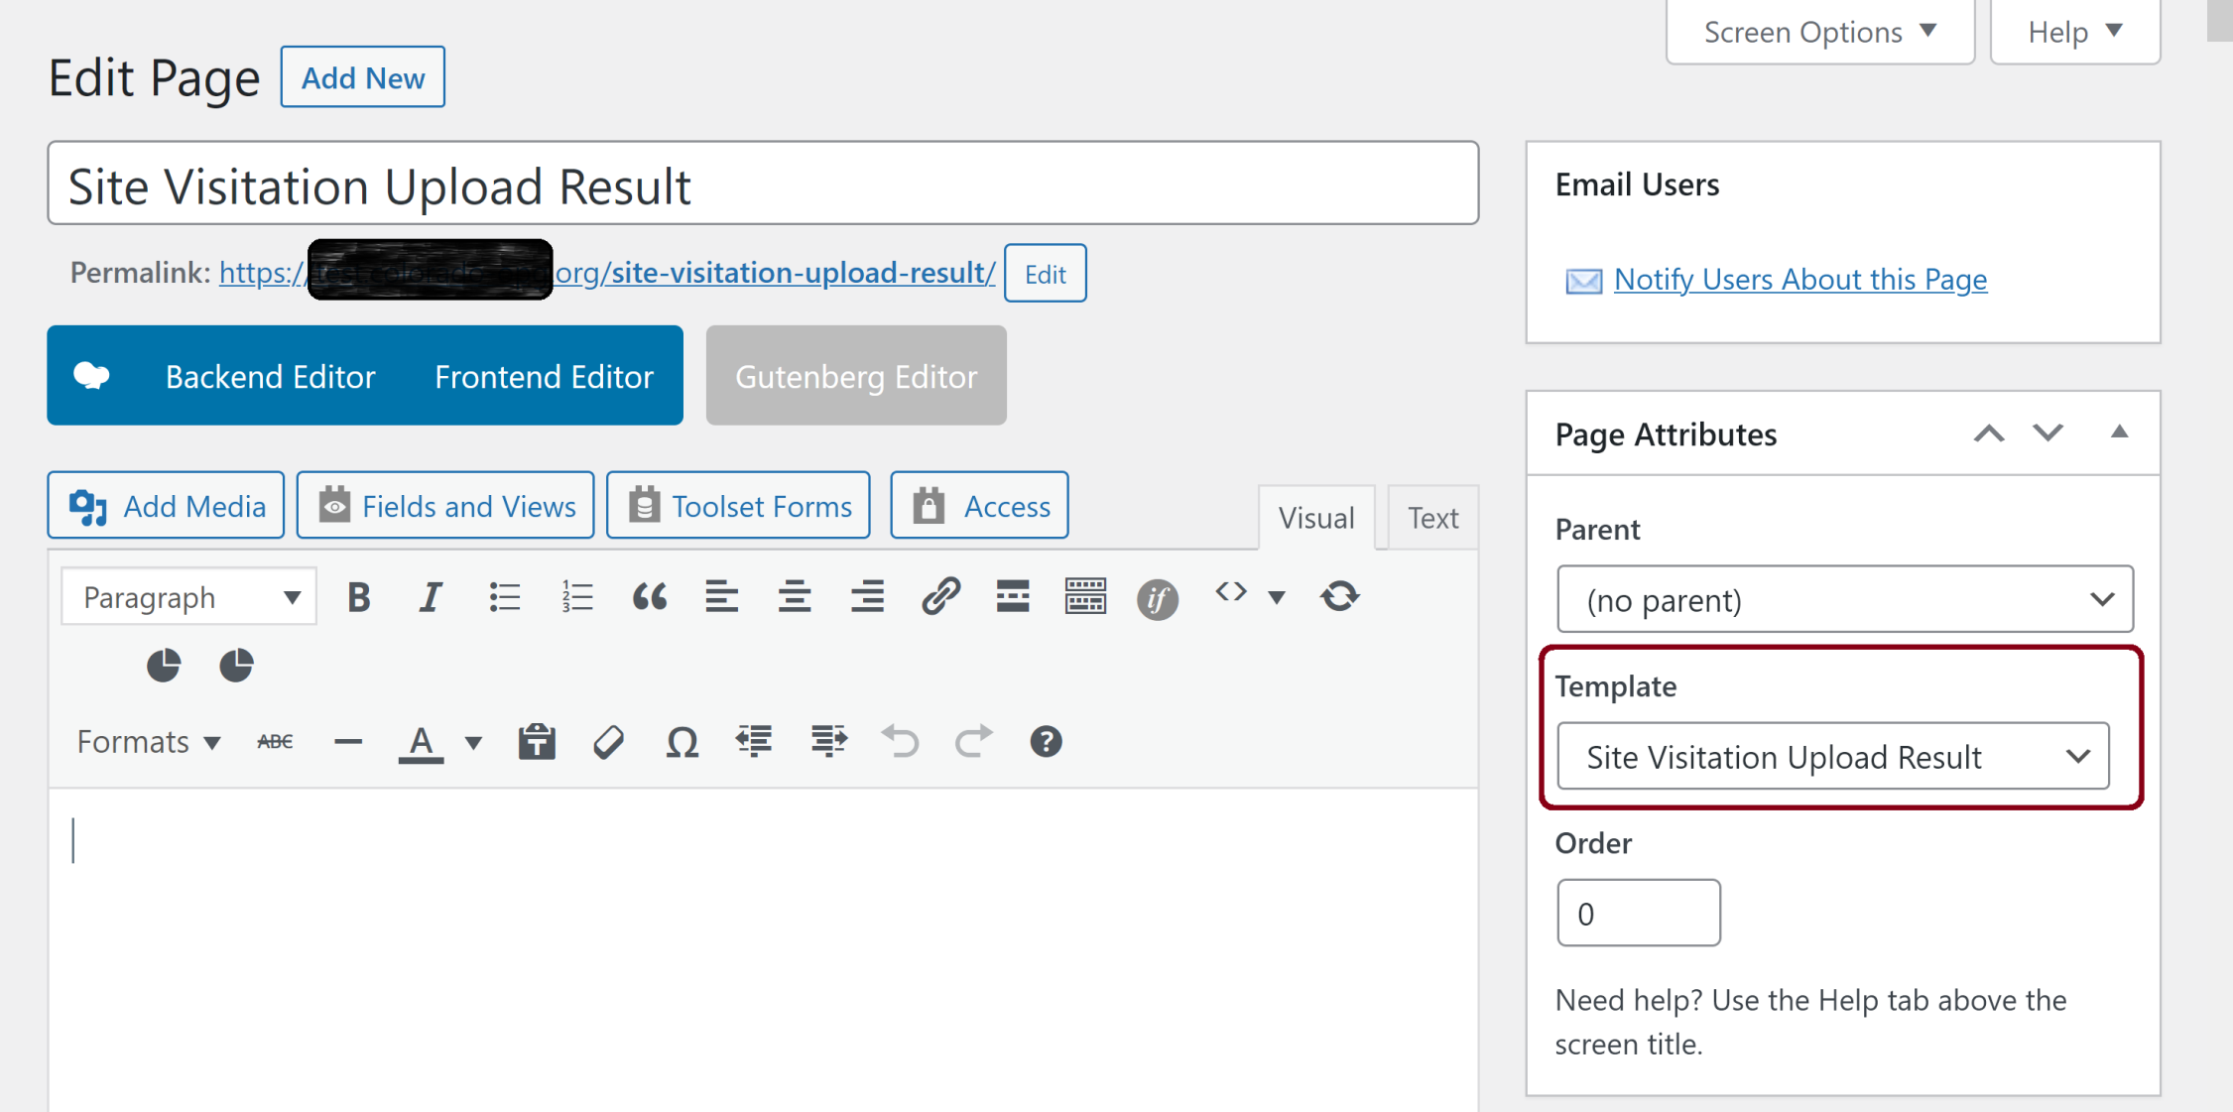
2. Use the Page Template
Go to WordPress pages.
https://example.com/wp-admin/edit.php?post_type=page
Create a new page.
Set the page template attribute value to the Site Visitation.

Slide 24
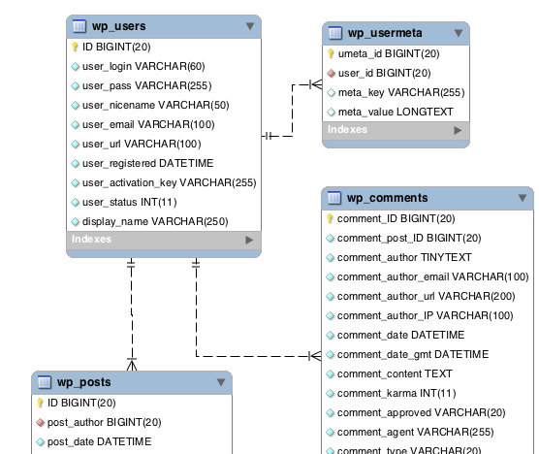
Database Diagram: Users, Posts
https://codex.wordpress.org/Database_Description

Slide 25
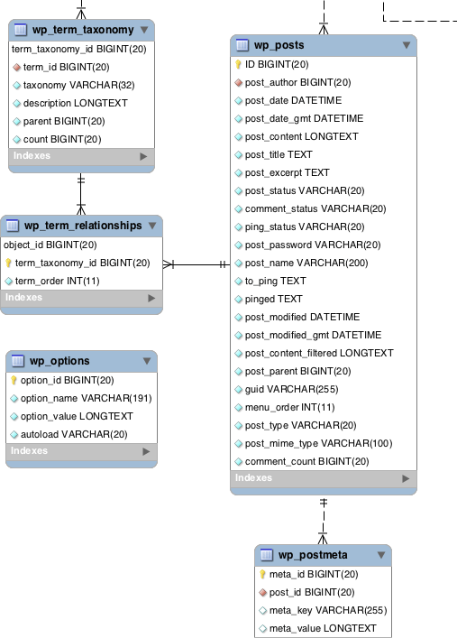
Database Diagram: Posts, Post Meta

Slide 26
Database Diagram: Posts, Attachments
https://developer.wordpress.org/themes/template-files-section/attachment-template-files/
Attachments are a special post type that holds information about a file uploaded through the WordPress media upload system, such as its description and name.
For images, as an example, the attachment post type links to metadata information, about the size of the images, the thumbnails generated, the location of the image files, the HTML alt text, and even information obtained from EXIF data embedded in the images.

Slide 27
Database Diagram: Attachments
The post that an attachment is related to is determined by the post_parent column on the wp_posts table.

Slide 29
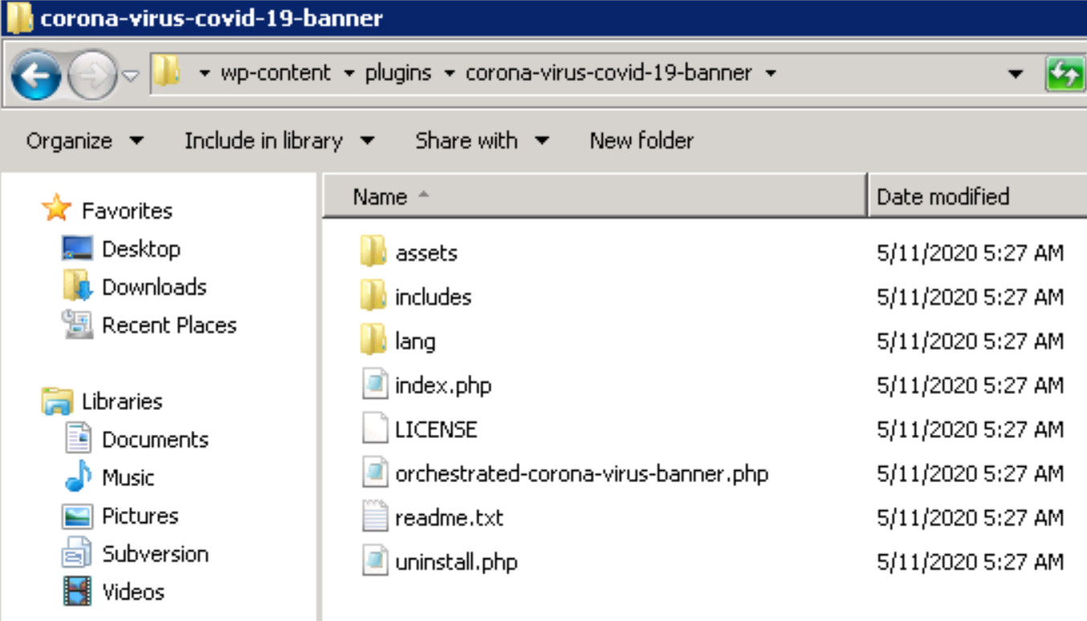
1. Create Plug-in Folder
It is best to review structure of an existing plug-in.

Slide 30
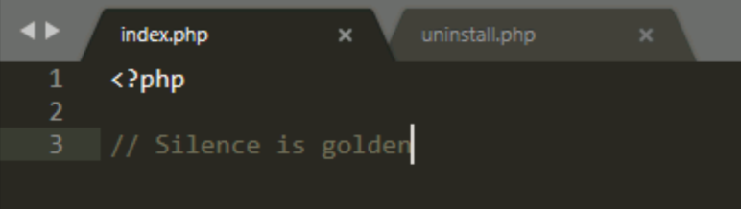
2. Create index.php
This file can be empty.

Slide 31
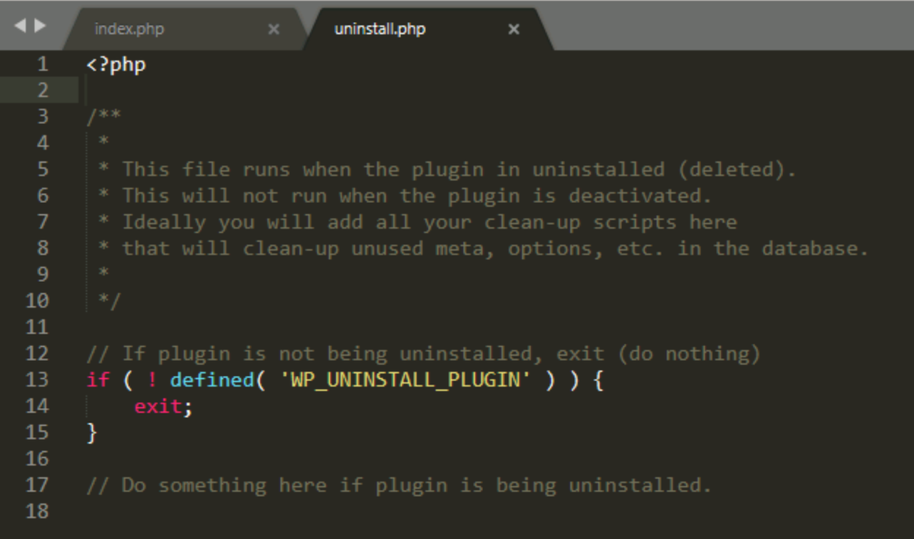
3. Create uninstall.php

Slide 32
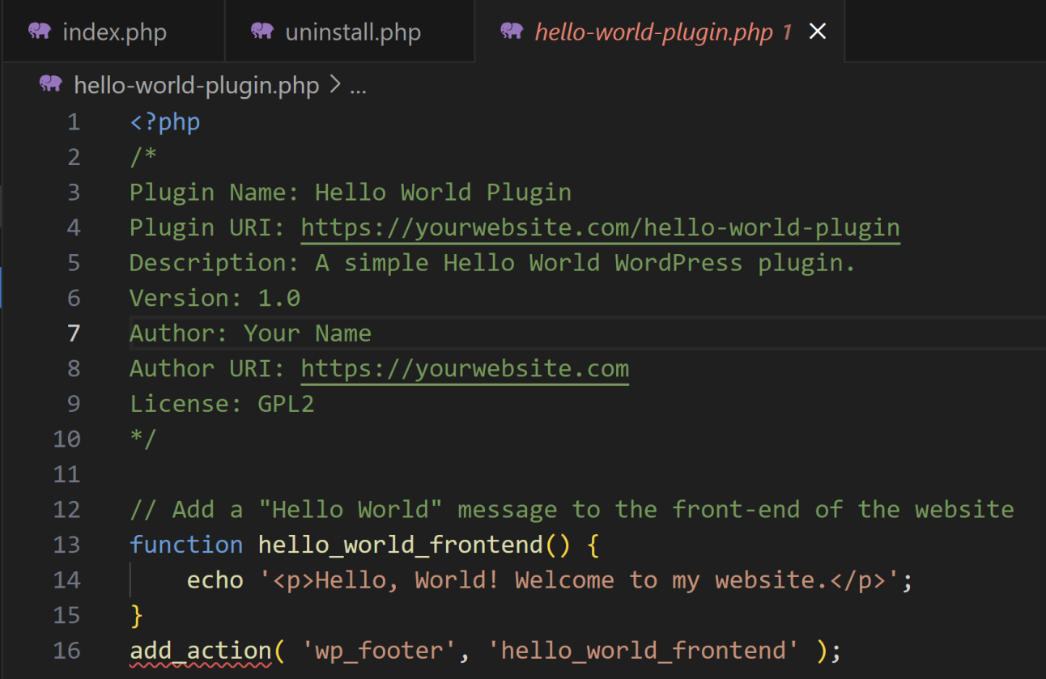
4. Create hello-world-plugin.php
It can be any php file as long as its name is unique.

Slide 33
register_activation_hook
Hook called when a plugin is activated.

Slide 34
Activate and Deactivate the Plug-in
Activating and then deactivating the Plug-in to test the new created plug-in.

Slide 36
What is WP-Cron
https://developer.wordpress.org/plugins/cron/
WP-Cron is how WordPress handles scheduling time-based tasks in WordPress.
Several WordPress core features, such as checking for updates and publishing scheduled post, utilize WP-Cron.
The “Cron” part of the name comes from the cron time-based task scheduling system that is available on UNIX systems.
WP-Cron works by checking, on every page load, a list of scheduled tasks to see what needs to be run. Any tasks due to run will be called during that page load.
WP-Cron does not run constantly as the system cron does; it is only triggered on page load.

Slide 37
Why Use WP-Cron
WordPress core and many plugins need a scheduling system to perform time-based tasks.
However, many hosting services are shared and do not provide access to the system scheduler.
Using the WordPress API is a simpler method for setting scheduled tasks than going outside of WordPress to the system scheduler.
With the system scheduler, if the time passes and the task did not run, it will not be re-attempted. With WP-Cron, all scheduled tasks are put into a queue and will run at the next opportunity (meaning the next page load). So while you can't be 100% sure when your task will run, you can be 100% sure that it will run eventually.

Slide 38
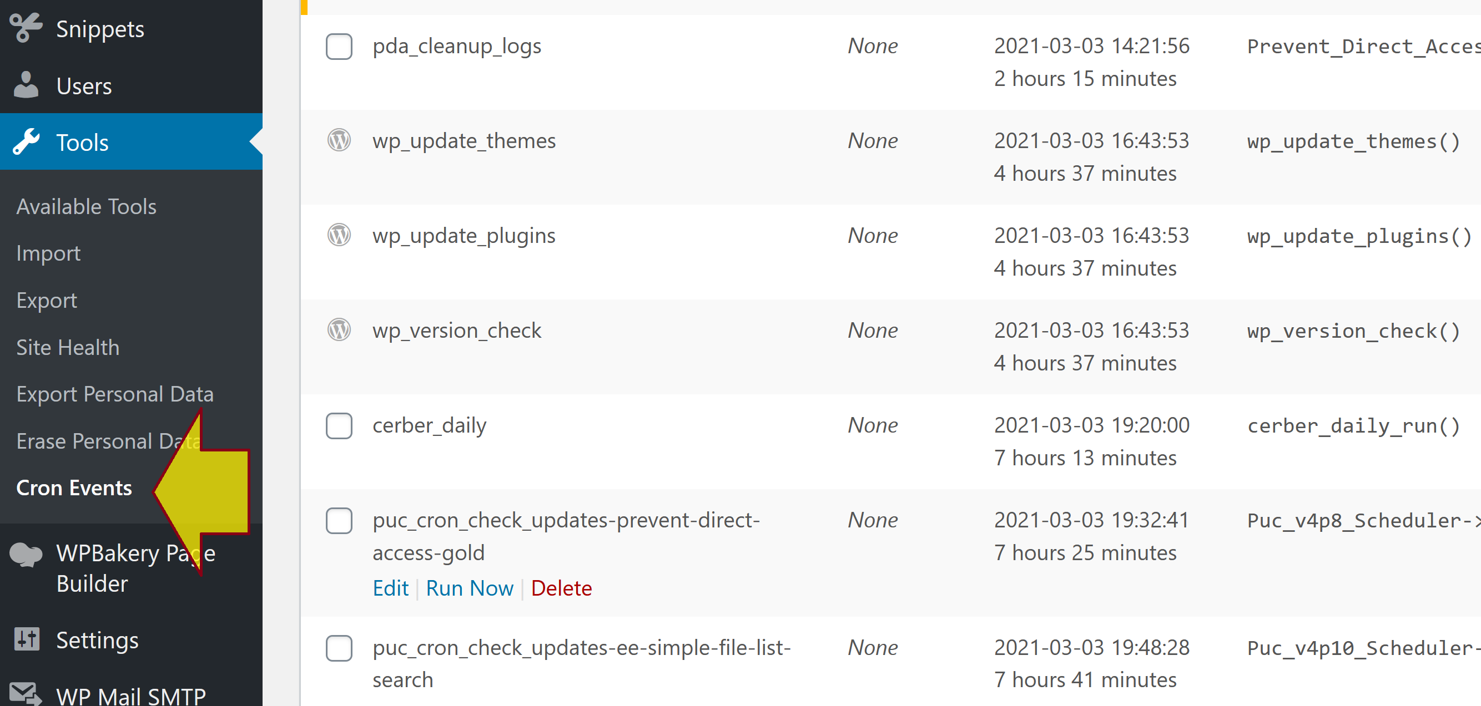
WP Crontrol Plug-in
https://wordpress.org/plugins/wp-crontrol/

Slide 39
Create a Cron Job in a Plug-in
public function __construct( $file = '', $version = '1.0.0' ) {
//* Load plugin environment variables
$this->file = $file;
register_activation_hook( $this->file, array( $this, 'rjcolorado_cron_schedule') );
add_action( 'rjcolorado_cron_hook', array( $this, 'rjcolorado_cron_profile_email_reminder'), 10 );
…
}
public function rjcolorado_cron_schedule() {
//verify event has not been scheduled
if ( ! wp_next_scheduled( 'rjcolorado_cron_hook' ) ) {
//schedule the event to run hourly
wp_schedule_event( time(), 'hourly', 'rjcolorado_cron_hook' );
}
}
public function rjcolorado_cron_profile_email_reminder() {
//send scheduled email
wp_mail( 'nhuybien@desabran.com', 'Profile Reminder', 'Please update your profile' );
}

Slide 40
Run a Test
<?php
require_once("wp-load.php");
define('WP_USE_THEMES', false);
require_once( 'wp-content/plugins/rjcolorado/includes/rjcolorado.php' );
$instance = RJColorado::instance( __FILE__, '1.0.0.0' );
// $users = $instance->get_users_by_role( 'um_practitioner' , 'display_name' , 'ASC');
// $userlist = $instance->test_get_users_by_role();
// echo $userlist;
$instance->rjcolorado_cron_profile_email_reminder();
echo "Email sent successfully."
?>

Slide 42
Theme Folder Structure [2]
Themes reside in the wp-content/themes/ directory.
/: The root theme directory is where all main template files and the style.css file are stored.
/images/: The main folder for all images used in the theme.
/js/: All JavaScript files should be stored in their own folder.
/languages/: If your theme is multilingual, all languages files should be stored in a languages directory
/css/: Any additional CSS files should be stored in and loaded from a css/ directory.
/inc/: Can be used for additional PHP files that may be needed for functionality in the theme.

Slide 43
A Typical WordPress Theme Anatomy
Every theme created must have at least these two files
index.php
style.css
WordPress uses the index.php file as the default file for rendering a web site.
The most important feature of the style.css file is that it holds all the metadata for your theme, which is displayed in the theme manager.

Slide 44
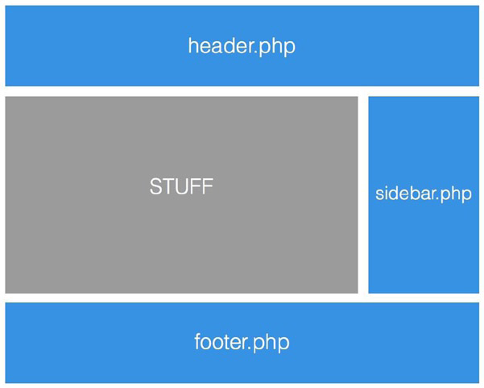
The index.php File

Slide 45
header.php
<?php
/* The Header for our theme. */
?><!DOCTYPE html>
<html <?php language_attributes(); ?>>
<head>
<meta charset="<?php bloginfo( 'charset' ); ?>" />
<meta name="viewport" content="width=device-width" />
<title><?php wp_title( '|', true, 'right' ); ?></title>
<!-- HTML5 SHIV for IE --><!-- If using Modernizr you can remove this script! -->
<!--[if lt IE 9]>
<script src="//html5shiv.googlecode.com/svn/trunk/html5.js"></script>
<![endif]-->
<?php wp_head(); ?>
</head>
HTML generated from the preceding wp_head() function call:
<meta name='robots' content='noindex,nofollow' />
<link rel='stylesheet' id='twelvedevs-style-css' href='http://12devs.dev/wordpress/wp-content/
themes/12devs/style.css?ver=3.5.1' type='text/css' media='all' />

Slide 46
Including Basic Template Files to index.php
You need to actually include them in your main template files.
Each of the previous files could be included with a regular PHP include() call, but WordPress goes one
better and furnishes some template functions to use specifically for each of the base files:
get_header()
get_footer()
get_sidebar()
get_search_form()
comments_template()
<?php get_header(); ?>
<div class="container">
<div class="search">
<?php get_search_form(); ?>
</div>
<div class="main">
<?php // do stuff ?>
<?php comments_template(); ?>
</div>
<?php get_sidebar(); ?>
</div>
<?php get_footer(); ?>

Slide 47
Functions File
The functions file of a WordPress theme (functions.php in the root of your theme) acts as your own little
plugin. It gets loaded automatically by WordPress when a page is initialized in both the front end and admin of your
site. It can be used for a variety of functions:
To set up WordPress functionality such as post-thumbnails or custom post types
To define functions that can be used throughout your theme templates
To change the WordPress admin or add in options pages
<?php
/**
* Pro WordPress functions and definitions
*
* @package prowordpress
*/
add_theme_support( 'automatic-feed-links' );
add_theme_support( 'post-thumbnails' );

Slide 48
Template Hierarchy
page.php
single.php
attachment.php
image.php
video.php
text.php
archive.php
taxonomy.php
category.php
date.php
tag.php
author.php
page.php template is used to generate and display the pages in your WordPress site. If you need to create a custom template for a specific page, you can do it easily by using the page's slug, which is usually a lowercase, hyphenated version of the page title.
The single.php template is used to display all individual posts.
The attachment.php file is used to display any attachments that can be directly linked to from the WordPress front end.

Slide 49
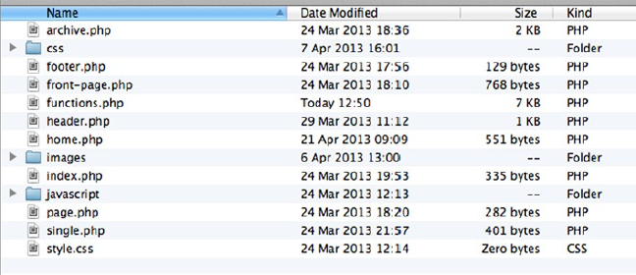
Building Your Theme

Slide 50
Template Tags
The WordPress template tags are a simple way to access all the content you store in WordPress and get it into your themes.
Again the template tags; although they have the name “tags,” they are still just functions.
They are built into the WordPress core and process, and return or output the content stored in the database.
<img src="<?php bloginfo('template_directory'); ?>/images/logo.png" alt="Site logo" />
<h2><a href="<?php the_permalink(); ?>" title="<?php the_title_attribute(); ?>"><?php the_title(); ?></a></h2>
<?php $args = array(
'style' => 'ul',
'per_page' => 10,
'avatar_size' => 50,
);
wp_list_comments($args); ?>

Slide 51
Constructing the Page
<?php
/**
* Front to the WordPress application. This file doesn't do anything, but loads
* wp-blog-header.php which does and tells WordPress to load the theme.
*
* @package WordPress
*/
/**
* Tells WordPress to load the WordPress theme and output it.
*
* @var bool
*/
define('WP_USE_THEMES', true);
/** Loads the WordPress Environment and Template */
require('./wp-blog-header.php');
It all begins with one file, though; every request made to a WordPress web site goes through the index.php file.

Slide 52
wp-blog-header.php
<?php
/**
* Loads the WordPress environment and template.
*
* @package WordPress
*/
if ( !isset($wp_did_header) ) {
$wp_did_header = true;
require_once( dirname(__FILE__) . '/wp-load.php' );
wp();
require_once( ABSPATH . WPINC . '/template-loader.php' );
}
The wp-load file sets up the database connection and a whole load of other things (such as the settings for the theme)
and includes most of the other files that are necessary for WordPress to work.
After wp-load has done its work, the wp() function is called,
which sets up the main query by adding the current query parameters to the main WP_Query instance in use.
At the heart of WordPress is the query, or more accurately, WP_Query – the PHP class that handles a lot of things for you.

Slide 53
template-loader.php
/**
* Retrieve path of page template in current or parent template.
*
* Will first look for the specifically assigned page template
* The will search for 'page-{slug}.php' followed by 'page-id.php'
* and finally 'page.php'
*
* @since 1.5.0
*
* @return string
*/
function get_page_template() {
$id = get_queried_object_id();
$template = get_page_template_slug();
$pagename = get_query_var('pagename');
if ( ! $pagename && $id ) {
// If a static page is set as the front page, $pagename will not be set. Retrieve it
from the queried object
$post = get_queried_object();
$pagename = $post->post_name;
}
$templates = array();
if ( $template && 0 === validate_file( $template ) )
$templates[] = $template;
if ( $pagename )
$templates[] = "page-$pagename.php";
if ( $id )
$templates[] = "page-$id.php";
$templates[] = 'page.php';
return get_query_template( 'page', $templates );
}
The wp-load file sets up the database connection and a whole load of other things (such as the settings for the theme)
and includes most of the other files that are necessary for WordPress to work.
After wp-load has done its work, the wp() function is called,
which sets up the main query by adding the current query parameters to the main WP_Query instance in use.
At the heart of WordPress is the query, or more accurately, WP_Query – the PHP class that handles a lot of things for you.

Slide 55
1. Why Create a Child Theme?
Keeping your modifications in a separate folder from your theme.
Updating the parent theme without losing your customizations.

Slide 56
2. Create a Child Theme Folder
Example: Divi-Child
Copy the child theme folder to the wp-content/themes/ folder.

Slide 57
3. Create style.css
/*
Theme Name: Divi Child
Theme URI: https://example.com/divi-child/
Description: Divi Child Theme
Author: Ngo Huy Bien
Author URI: https://example.com
Template: Divi
Version: 1.0.0
License: GNU General Public License v2 or later
License URI: http://www.gnu.org/licenses/gpl-2.0.html
*/

Slide 58
4. Create functions.php
To enqueue the parent and child themes' stylesheets.
<?php
function enqueue_parent_styles() {
wp_enqueue_style( 'parent-style', get_template_directory_uri() . '/style.css' );
}
add_action( 'wp_enqueue_scripts', 'enqueue_parent_styles' );
add_filter( 'auto_update_plugin', '__return_true' );
add_filter( 'auto_update_theme', '__return_true' );

Slide 59
5. Create screenshot.png
This step is optional.
More information: https://developer.wordpress.org/themes/advanced-topics/child-themes/

Slide 61
Writing Web Applications [3]
WordPress ships with
A database with a flexible data schema
A core application layer with numerous hooks of which we can take advantage
The ability to handle client-side, server-side, user-facing, and administrator-facing tasks
It's an application unto itself that can be extended into further applications.
Things such as Rails, Laravel, CakePHP, Zend, and CodeIgnitor can't actually do anything until you give them enough code to do so.

Slide 62
The Components of WordPress
The Database Layer is a MySQL database.
The Application Layer - which some would consider WordPress itself - is written in PHP and handles a lot of the core operations for reading and writing to the data store all the while providing APIs for developers to take further advantage of it.
The Presentation Layer uses basic CSS (at least for now), HTML (with some themes now using HTML5), jQuery, and with parts of the dashboard using Backbone.js.
WordPress provides hooks which are literally points in execution in which we can introduce our own functionality such that WordPress recognizes that "when this event happens, I need to fire these functions" where these functions are defined as whatever we've provided.

Slide 63
Understanding Events
In the context of a single page load, there are a number of things that occur:
JavaScript and stylesheets are retrieved.
Queries are run against the database to retrieve data.
The information from the database is rendered within the context of the markup.
The page is presented to the user.
...and so on.
All of these can be considered events, but each of these is made up of their own set of smaller events.
http://codex.wordpress.org/Plugin_API/Action_Reference#Actions_Run_During_a_Typical_Request

Slide 64
Hooks: Actions
In the world of event-driven programming, events are usually exposed in such a way that they allow us to hook into them and manipulate information before it's rendered to the client.
In WordPress, hooks come in two varieties: Actions and Filters.
Actions are a type of hook that signify that something has happened, and when that something occurs, we have the ability to register our own functionality such that we can inject our own code (or even prevent certain things from happening).
Actions are functions that are fired as a result of an event that has occurred during the execution of WordPress.

Slide 65
add_action
https://developer.wordpress.org/reference/functions/add_action/
Hooks a function on to a specific action.
add_action( $hook, $function_to_add, $priority, $accepted_args );
To find out the number and name of arguments for an action, simply search the code base for the matching do_action() call.
For example, if you are hooking into 'save_post', you would find it in post.php:
do_action( 'save_post', $post_ID, $post, $update );
Your add_action call would look like:
add_action( 'save_post', 'wpdocs_my_save_post', 10, 3 );
And your function would be:
function wpdocs_my_save_post( $post_ID, $post, $update ) {
// do stuff here
}

Slide 66
Execution Order
add_action( $hook, $function_to_add, $priority, $accepted_args );
$priority
(int) (Optional) Used to specify the order in which the functions associated with a particular action are executed.
Lower numbers correspond with earlier execution, and functions with the same priority are executed in the order in which they were added to the action.
Default value: 10

Slide 67
Example
To email some friends whenever an entry is posted on your blog:
/**
* Send email to my friends.
*
* @param int $post_id Post ID.
* @return int Post ID.
*/
function wpdocs_email_friends( $post_id ) {
$friends = 'bob@example.org, susie@example.org';
wp_mail( $friends, "sally's blog updated", 'I just put something on my blog: http://blog.example.com' );
return $post_id;
}
add_action( 'publish_post', 'wpdocs_email_friends' );

Slide 68
Use Actions with a Class
To use add_action() when your plugin or theme is built using classes, you need to use the array callable syntax.
You would pass the function to add_action() as an array, with $this as the first element, then the name of the class method, like so:
class WP_Docs_Class {
public function __construct() {
add_action( 'save_post', array( $this, 'wpdocs_save_posts' ) );
}
/**
* Handle saving post data.
*/
public function wpdocs_save_posts() {
// do stuff here...
}
}
$wpdocsclass = new WP_Docs_Class();

Slide 69
wp_enqueue_scripts
This fires during the page loading sequence and allows you to tell WordPress what source files it should include as well as where it should include it (as in, in the header or the footer).
// somewhere in my theme's functions.php
function example_add_theme_scripts() {
wp_enqueue_script( 're-example-script', get_stylesheet_directory_uri() . '/js/example.js',
array( 'jquery' ),
'1.0.0', FALSE );
}
add_action( 'wp_enqueue_scripts', 're_add_theme_scripts' );

Slide 70
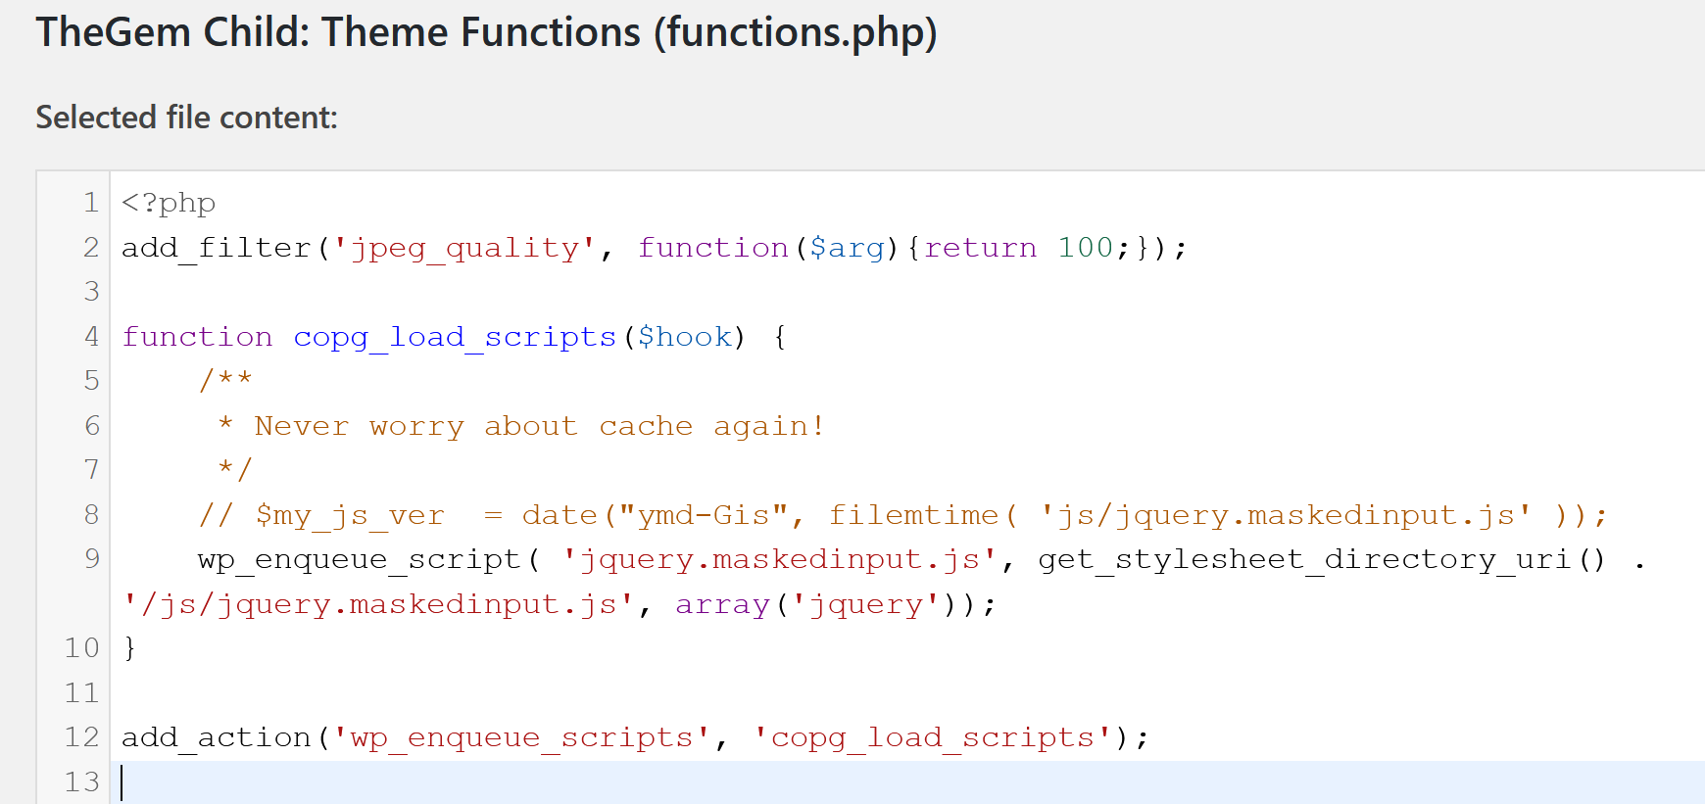
Example (in a Theme Child)
function copg_load_scripts($hook) {
/**
* Never worry about cache again!
*/
// $my_js_ver = date("ymd-Gis", filemtime( 'js/jquery.maskedinput.js' ));
wp_enqueue_script( 'jquery.maskedinput.js', get_stylesheet_directory_uri() . '/js/jquery.maskedinput.js', array('jquery'));
}
add_action('wp_enqueue_scripts', 'copg_load_scripts');

Slide 71
Hooks: Filters
Filters, on the other hand, a type of hook that allow us to receive a certain piece of data, manipulate it, and then return it back to WordPress before rendering it to the browser.
Filters are functions that WordPress passes data through during certain points of the page lifecycle.
They are primarily responsible for intercepting, managing, and returning data before rendering it to the browser or saving data from the browser to the database.

Slide 72
the_content Filter
the_content filter passes the actual content of the post to the hooked function. From there, we're free to manipulate the data in any way that we see fit.
function append_post_content( $content ) {
$html = '<div class="post-suffix">';
$html .= 'This content will appear at the end of a post.';
$html .= '</div>';
$content .= $html;
return $content;
}
add_filter( 'the_content', 'append_post_content', 1 );

Slide 73
Show Post Type
function append_post_content( $content ) {
global $post;
$html = '<div class="post-suffix">';
$html .= 'This content will appear at the end of a page post. post_type: <strong>';
$html .= $post->post_type;
$html .= '</strong>.';
$html .= '</div>';
$content .= $html;
return $content;
}
add_filter( 'the_content', 'append_post_content', 1 );

Slide 74
List Post Types
function append_post_content( $content ) {
global $post;
if( 'thegem_team_person' == $post->post_type ) {
$args = array(
// 'public' => true,
'_builtin' => false,
);
$output = 'names'; // names or objects, note names is the default
$operator = 'and'; // 'and' or 'or'
$post_types = get_post_types( $args, $output, $operator );
$html = '<div class="post-suffix">';
foreach ( $post_types as $post_type ) {
$html .= '<p>' . $post_type . '</p>';
}
$html .= '</div>';
$content .= $html;
}
return $content;
}

Slide 76
get_post_meta
https://developer.wordpress.org/reference/functions/get_post_meta/
get_post_meta( int $post_id, string $key = '', bool $single = false ): mixed
Retrieves a post meta field for the given post ID.

Slide 77
attachment_url_to_postid
https://developer.wordpress.org/reference/functions/attachment_url_to_postid/
attachment_url_to_postid( string $url ): int
Tries to convert an attachment URL into a post ID.

Slide 78
attachment_url_to_postid Issue
I recently needed a way to get the ID of a WordPress image attachment, but I only had the image URL to work with. The problem was complicated by the fact that the image URL could be a thumbnail of the original image attachment, i.e. one of the auto-generated post thumbnail image sizes.
Solution:
// Gets attachment ID from attachment URL
function copg_get_attachment_id( $attachment_url ) {
global $wpdb;
$attachment_post = $wpdb->get_col($wpdb->prepare("SELECT ID FROM $wpdb->posts WHERE guid='%s';", $attachment_url ));
if ( count( $attachment_post ) > 0 ) {
return $attachment_post[0];
}
else {
return 0;
}
}

Slide 80

Thank You & See You Again

